Slide 2
Integrating data, modeling and tools into Basin Planning
Basin Planning
Water management requires planning
- Supply
- Demand
- Future (trends / scenarios)
Considers economic, social, and environmental issues
Based on best science and engineering subject to continuous adaptation
- underpinned by quality data
Provides the strategic framework for action

Slide 3
Components of Water Planning
Issues of common concern
Quantifies water and groundwater resources
Trend analysis
Water supply options
Water demand options
Water use monitoring
Water quality and management
Environmental management
Information and data needs
Information sharing
Institutional arrangements (options)
Govt, community and stakeholder engagement
Monitoring and evaluation

Slide 4
Context - The Murray –Darling Basin
4 states and 1 territory
1 million square kilometres
23 river valleys (84% of use)
81 groundwater sources (16% of use)
Extends across four States and the ACT
40% of Australia’s agricultural production, 75% of irrigated agriculture
Water is shared between states under Agreement

Slide 5
Governance arrangements
Ownership and management of water is state responsibility
Water is shared under inter-state agreement
State’s prepare water plans, consistent with a Basin Plan
Surface water and groundwater diversions are limited to Sustainable Diversion Limits
Water diversions (other than basic human rights) are licensed and listed on government registers or provided for in statutory plans
Diversions are monitored (metering)
Licensed users pay costs of water supply and management
Access and Use entitlements
Strong compliance

Slide 6
The Murray-Darling Basin Plan
Sustainable Diversion Limits for all rivers and aquifers
- to protect the health and productivity of water sources
- recovery of 27 million cubic metres from current diversions
Environmental Watering Plan
Water quality and salinity targets
Permanent and temporary trade of water entitlements
Community and stakeholder engagement in development of Plans
Monitoring and evaluation
- economic, environmental and social outcomes

Slide 7
Community Engagement and Citizen Science

Slide 8
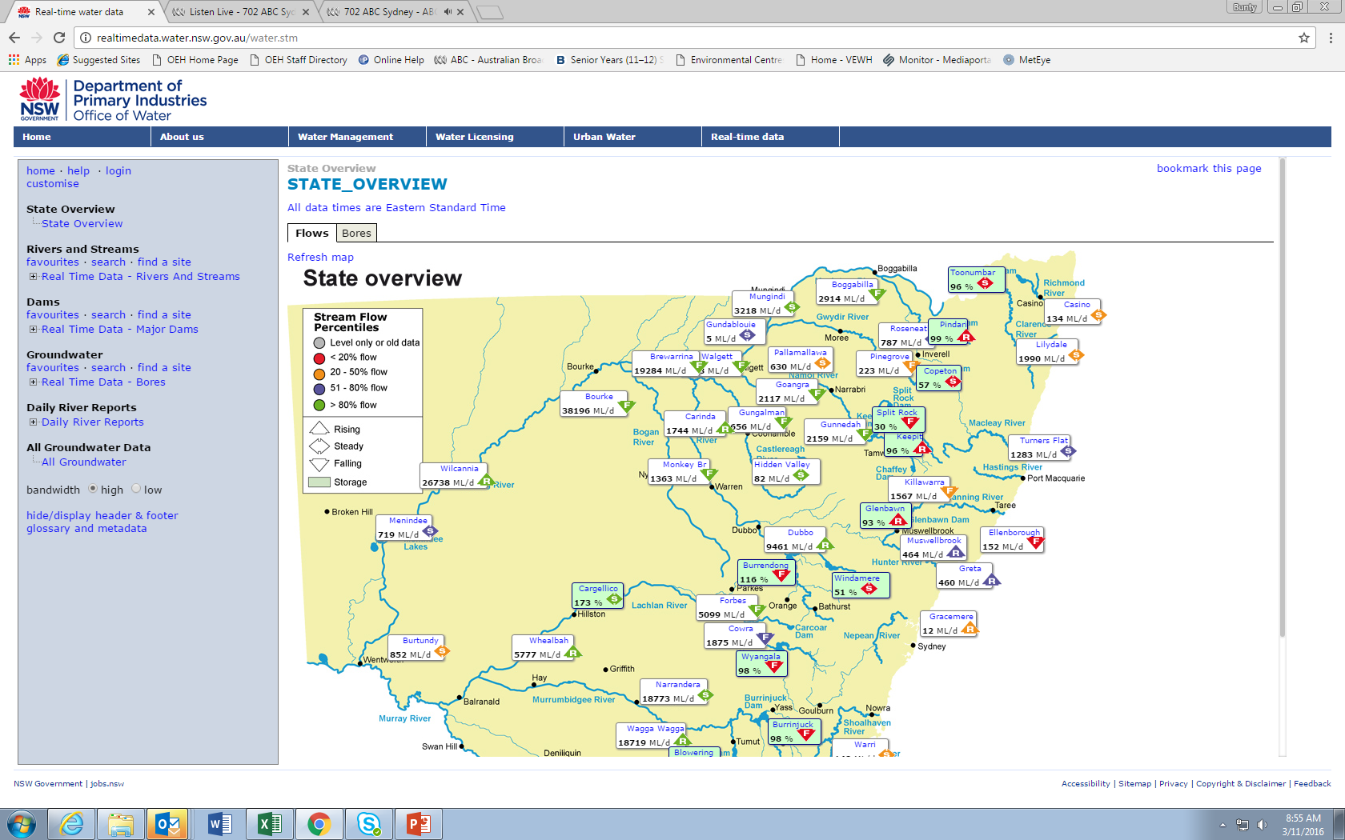
Access to information – Real time Data

Slide 9
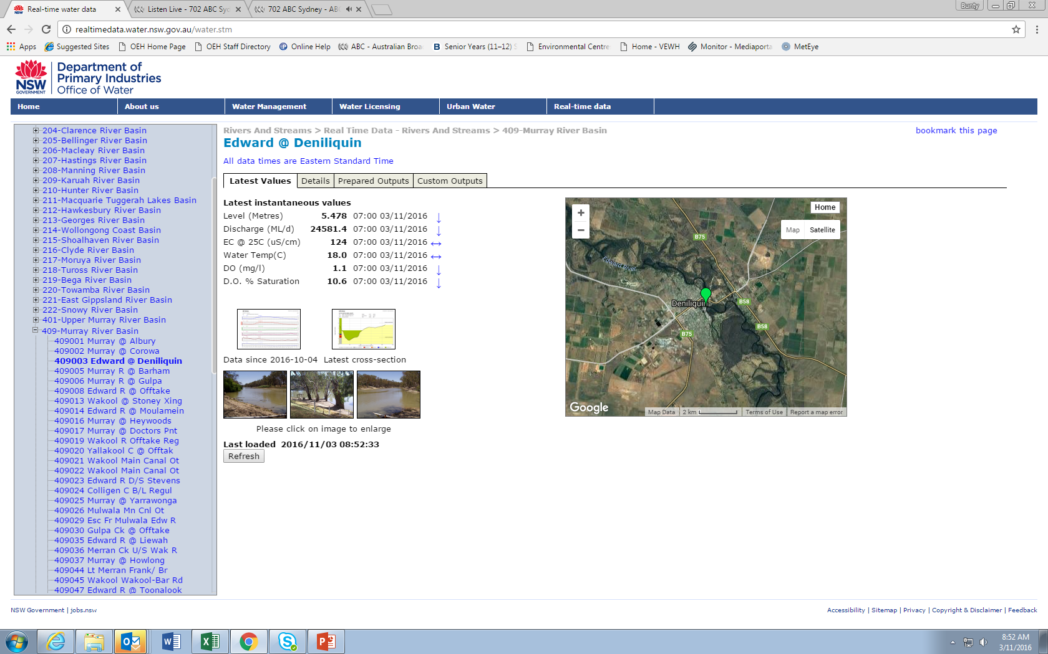

Slide 10
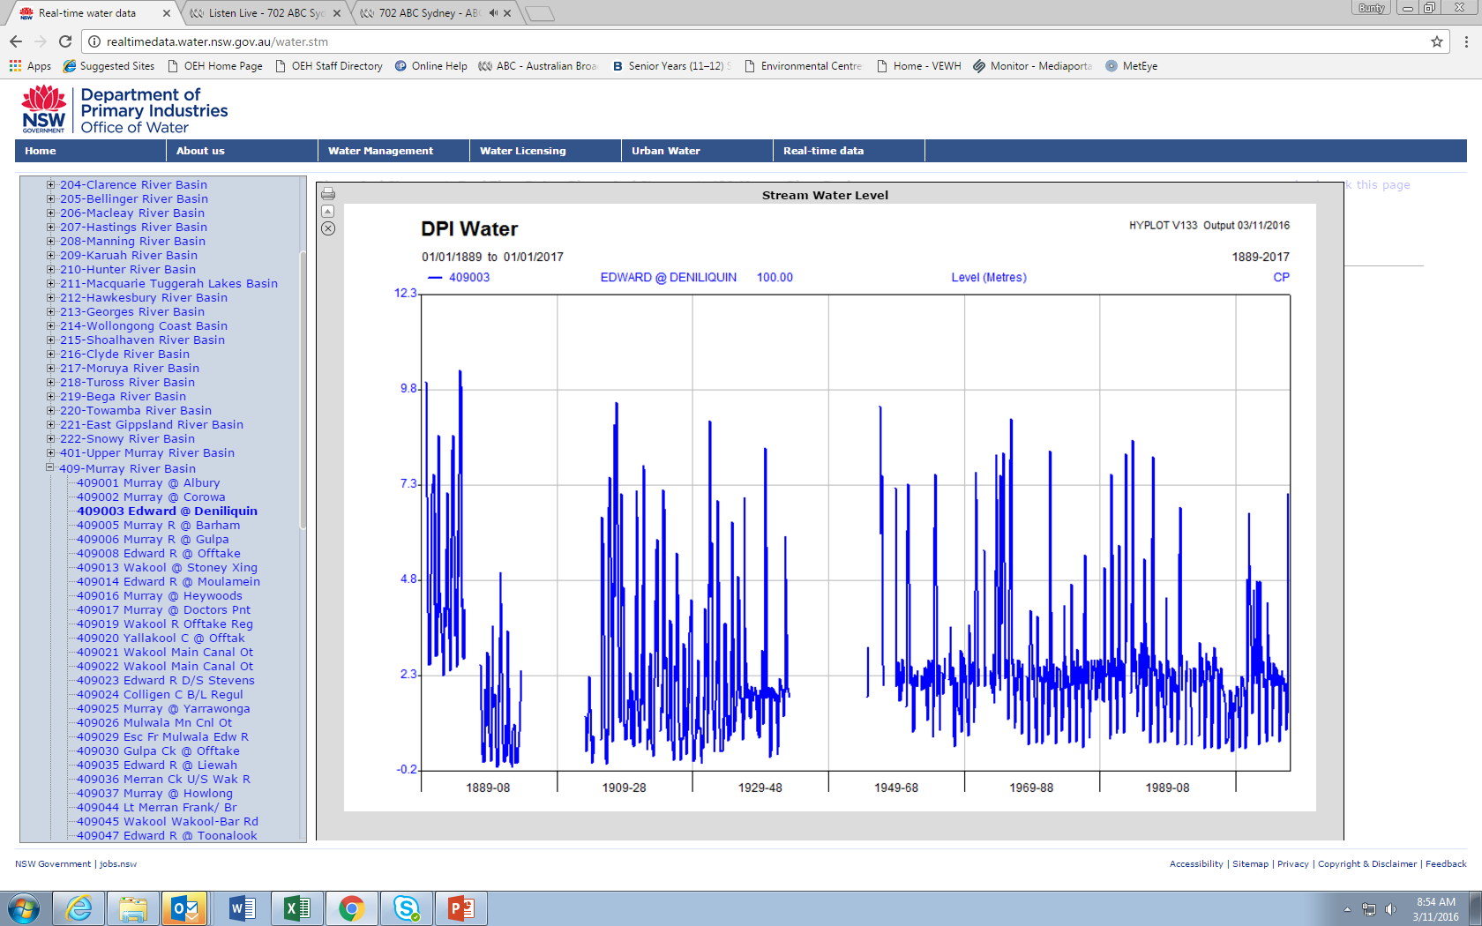

Slide 11
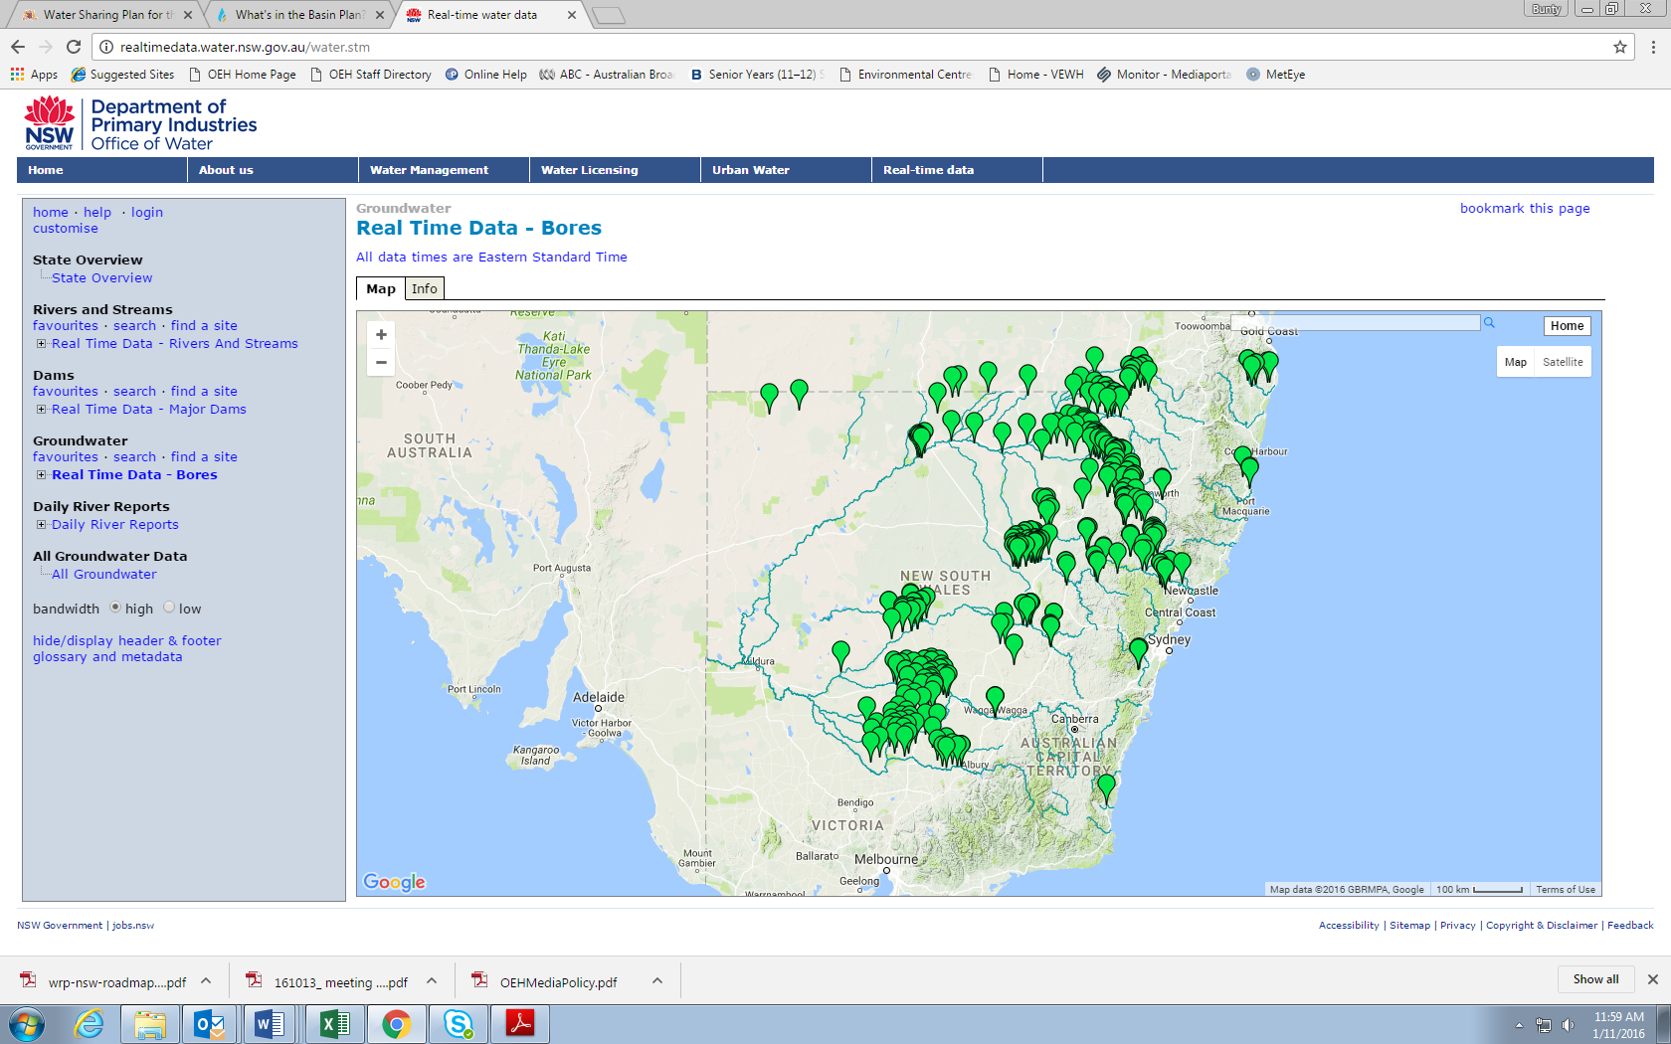

Slide 12
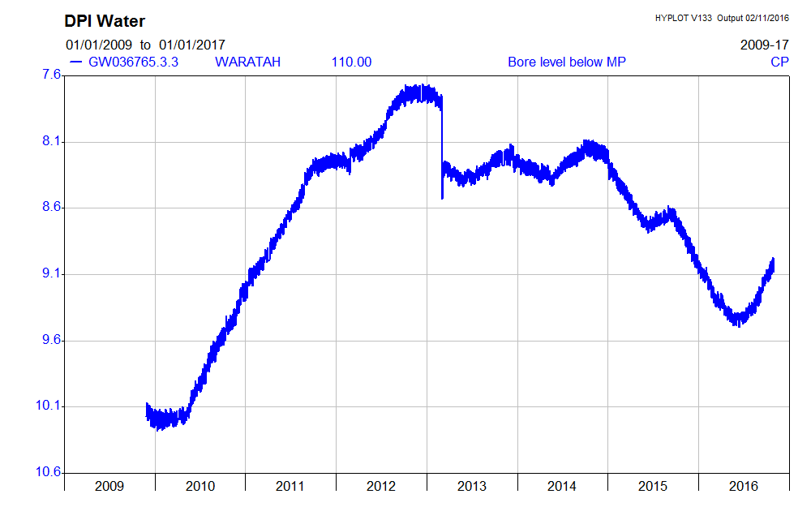

Slide 13
Relevance across countries in the region
Many (most) countries Asia, Africa, North and South America, Asia-Pacific face severe water shortages and other water management issues
Most countries are having difficulty in implementing necessary water management reforms
Water reform is hard, doing nothing is not a viable option and there is no simple solution
“ for every complex problem there is an answer that is clear, simple and wrong” (HL Mencken)
Water reforms in Australia are suited to that environment
Some elements of water reform in Australia may be applicable in other countries
Demand management is fundamental to address severe water shortage
Reforms have included investment in infrastructure and water use efficiency, institutional reform and policy development and implementation
Water reform is a long process that includes continual adaptation

Slide 14
Lessons learned
Stakeholder engagement in policy development and implementation is significant in contributing to the success of water planning
the greater their understanding of the issue the more that all sectors of government and community can be part of the solution
Governments do not have a monopoly on ideas
Water reforms must address social, economic and sustainability components
infrastructure and technical solutions are an important part of the water reform package
Water planning and implementation is hard, but is critical for targeting investment and achieving change and outcomes over time
doing nothing is not an option

Slide 15
Thank you

